Slide 1
Molecular Biology
Chapter 20--Cancer
Qihui Jiang (Vivi Kasim), Ph.D.
College of Bioengineering,
Chongqing University

Slide 2
Review (1)
What are the characteristics of living cells?
Proliferation
Respiration
Metabolism
Migration
Communication
Adaptation
Differentiation, etc.

Slide 3
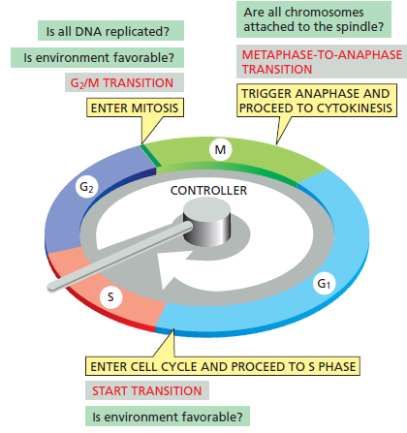
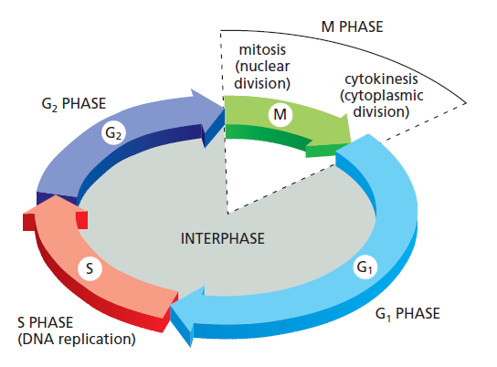
Review (2)
What are the phases in
cell cycles ?
What factors determine
cell cycle progression?
Is there any DNA damage?
Are all chromosomes attached to the spindle?
Is all DNA replicated?
Is environment favorable?
Metaphase-to-anaphase transition
G2/M transition
Trigger anaphase & proceed to cytokinesis
Enter mitosis
Enter cell cycle & proceed to S phase
Start transition
Is environment favorable?
Is there any DNA damage?
Is the size of the cell big enough?

Slide 4
Cells in their society
Somatic cells
Support
Germ cells
Collaboration
Self-sacrifice
Committed to die
Survive
Pass genetic information to progeny
Cells in multicellular organisms
behaves in a socially responsible manner:
resting
growing
dividing
differentiating
dying
etc.
All for the sake of the organism
Trouble!
If the harmony is disturbed

Slide 5
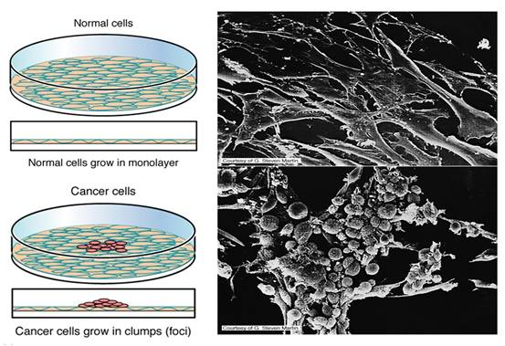
Abnormality in cell proliferation
Loss of cell proliferation control
Tumor (neoplasm)
Normal cells
Monolayer
Tumor cells
Grow in clumps

Slide 6
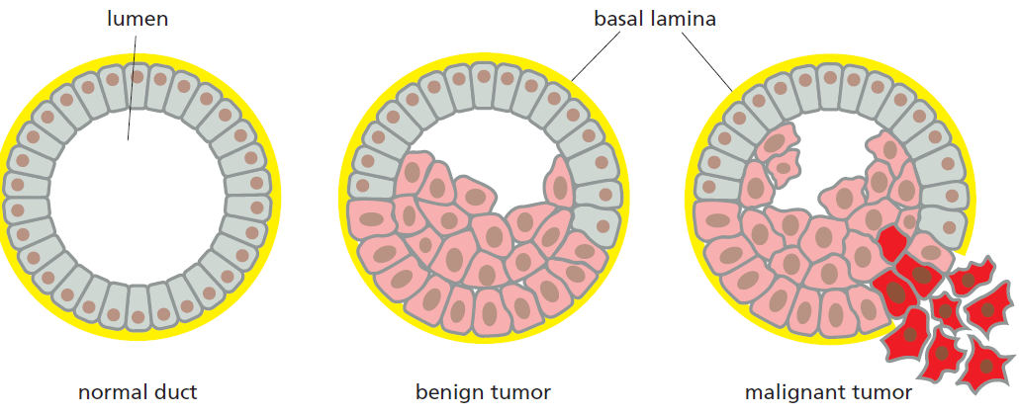
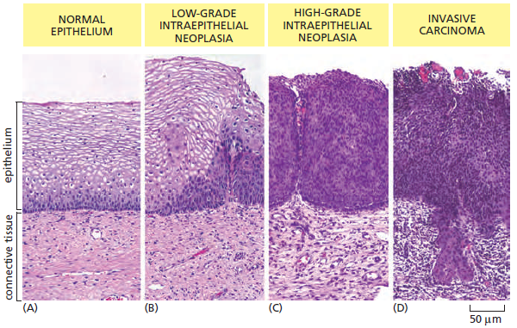
Benign & malignant tumor
Tumor (neoplasm)
lumen
basal lamina
Not invasive
(benign)
Invasive
(malignant)
Normal duct
adenoma
benign
malignant
adenocarcinoma

Slide 7
Example of benign tumor--syringoma

Slide 8
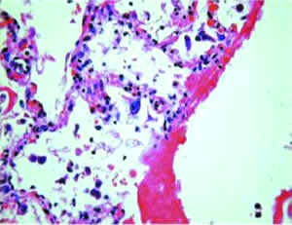
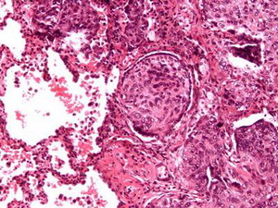
Malignant tumor
Alveolar cells
Lung cancer cells

Slide 9
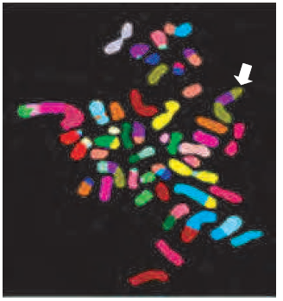
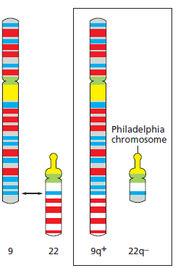
Genetic abnormalities of tumor cells
Chronic Myelogenous
Leukemia
Breast Tumor
Multiple translocations in a breast tumor cell
Karyotype: 48
White arrow:
doubly translocated chromosome made up of two pieces of chromosome 8 (green-brown) and one piece of chromosome 17 (purple)
Chromosomes 9 & 22 translocation
Found in almost all patients with
chronic myelogenous leukemia

Slide 10
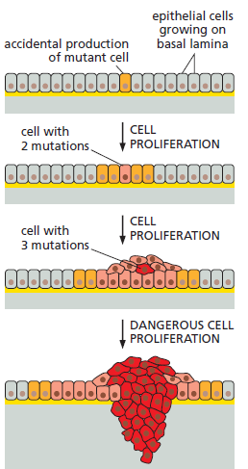
Mutation & Tumor Cells
In typical lifetime (human):
Cell divisions: around 10¹⁶ times
Mutation rate: 10⁻⁶/gene/cell division
10¹⁰ mutations/single gene
Epithelial cells growing on basal lamina
Accidental production of mutant cell
Cells with
2 mutations
Cell proliferation
Why tumor occurs so infrequently?
Cells with
3 mutations
Cell proliferation
Dangerous cell proliferation
The presence of tumor suppressor gene
Single mutation is not enough to induce tumor

Slide 11
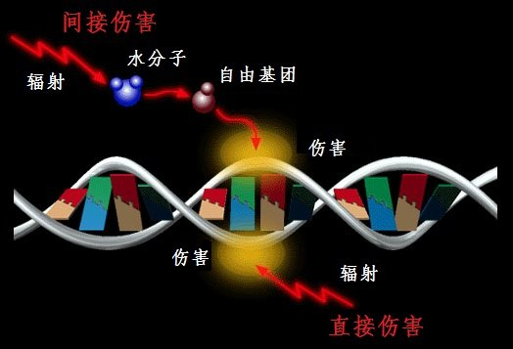
Factors that cause mutation— physical factors
Radiation (Ex: X-ray, UV radiation) will cause DNA damage
Examples:
Leukemia in the survival of Hiroshima & Nagasaki
Correlation between solar UV radiation & skin cancer
Indirect damage
H₂O
Radiation
Free radical
DNA damage
DNA damage
Radiation
Direct damage

Slide 12
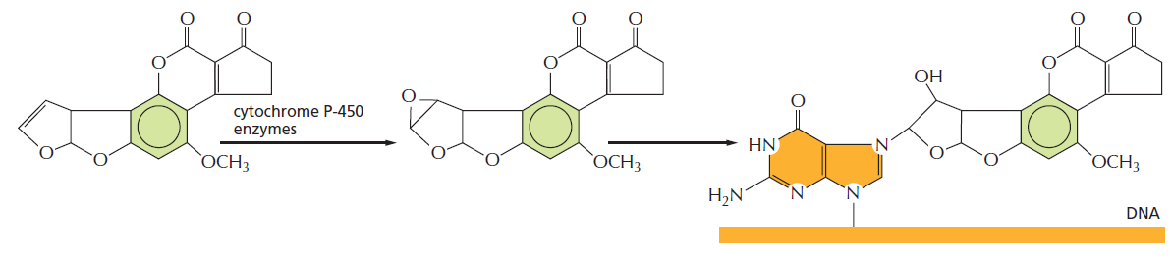
Factors that cause mutation— chemical compounds (carcinogen)
Carcinogen | Cancer
Tobacco smoke | Lung cancer
Aflatoxin | Liver cancer
Vinyl Chloride | Liver angiosarcoma
Benzene | Acute Leukemias
Arsenic | Skin carcinoma Bladder cancer
Asbestos | Mesothelioma
Radium | Osteosarcoma
Cytochrome
P-450
Aflatoxin
Aflatoxin-2,3-epoxide
Carcinogen bound to guanine in DNA

Slide 13
Factors that cause mutation— biological factors
Viral replication, host dies
DNA virus
Infected host cells
Insertion of viral DNA
into host’s gene
RNA virus
RNA infection
Protein
Reverse-transcribed
into viral DNA
Alteration of cells behaviours
Type | Pathogen | Associated cancer
DNA virus | Papillomavirus | Carcinoma of the uterine cervix
 | Hepatitis-B virus | Hepatocellular carcinoma
 | Epstein-Barr virus | Burkitt’s lymphoma Nasopharyngeal carcinoma
 | Human herpesvirus B | Kaposi’s sarcoma
RNA virus | Human T-cell leukemia virus type I (HTLV-1) | Adult T-cell leukemia / lymphoma
 | Hepatitis-C virus | Hepatocellular carcinoma
Bacterium | Helicobacter pylori | Stomach cancer

Slide 14
Critical Genes
Gain of function
Single mutation event
cell transformation
Proto-oncogene → oncogene
Normal cell
Activating mutation
Ex: Ras, Src, YY1, etc.
Loss of function
1st mutation
2nd mutation
inactivates
one gene copy
inactivates
2nd gene copy
cell transformation
Normal cell
no phenotype
2 inactivating mutations functionally eliminate the tumor suppressor gene
Ex: Rb, p53, p21, etc.

Slide 15
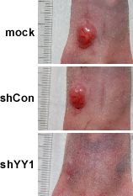
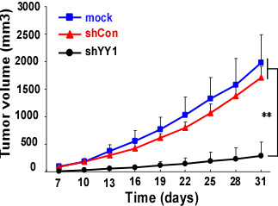
Oncogene
YY1: an oncogene overexpressed in various tumor tissues
shYY1: YY1-silenced tumor cells
Transplanted cells formed tumor
in the presence of YY1
Data from our work published in
Cancer Research, 2013;73(6):1787-99

Slide 16
Tumor Suppressor Gene
MDM2
p53
c-Myc
p21
CDK4/6
CDK1/2
CDK1/2
CDK1
CDK1
Cyclin D
Cyclin E
Cyclin A
Cyclin B
Cyclin A
G1
S
G2
M
Tumor suppressor gene: p53, p21
Oncogene: c-Myc, MDM2, CDK1, CDK2, CDK4, CDK6,
Cyclin A, Cyclin B, Cyclin D, Cyclin E

Slide 17
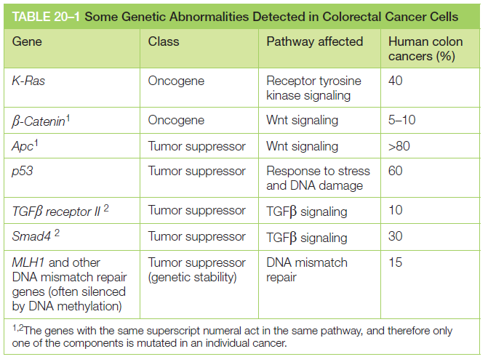
Genetic abnormalities in cancer cells

Slide 18
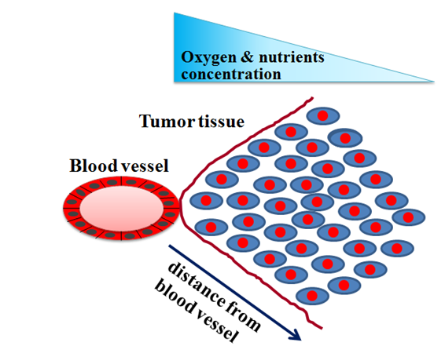
Tumor cells & its microenvironment
Tumor cells need adaptation

Slide 19
How to Adapt?
Formation of new blood vessels
Abnormal ability to survive stress & DNA damage
Altering its metabolic pathway

Slide 20
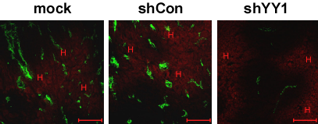
Formation of new blood vessels
Red: Hypoxic area; Green: blood vessels
shYY1: shRNA against YY1
Tumor tissue induces the formation of
new blood vessels in hypoxic area
Data from our work published in
Cancer Research, 2013;73(6):1787-99

Slide 21
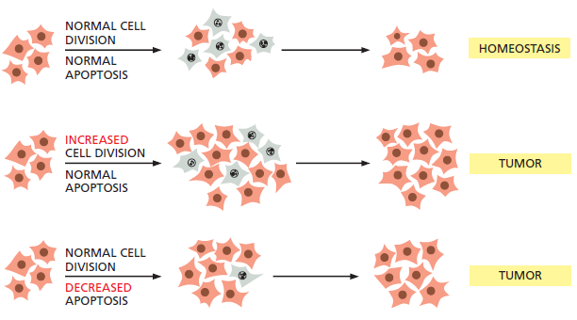
Abnormal survival & response to DNA damage
DNA damage
Normal cells
Tumor cells
Safety
mechanisms
Normal cell division
Homeostasis
Proliferation
Normal apoptosis
Increased
cell division
Proliferation
Apoptosis
Normal apoptosis
Tumor
Normal cell division
Tumor
Decreased apoptosis

Slide 22
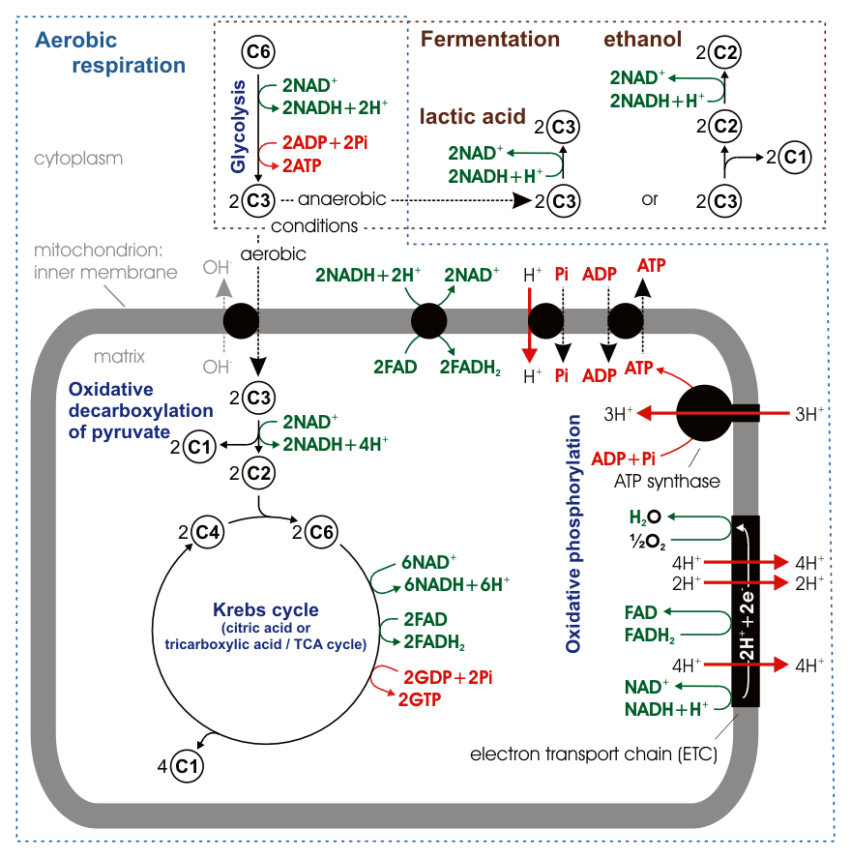
Metabolic pathways
GLUCOSE
GLUTs
Glucose-6-P
Fructose-6-P
Fructose-1.6-BP
Glyceraldehyde 3-P
1,3-bisphosphoglycerate
Glycerate 3-P
Phosphoenol pyruvate
PYRUVATE
Aerobic respiration: ≥30 ATPs
Glycolysis: 2 ATPs & 2 NADHs

Slide 23
Tumor Cells Metabolism
“Warburg effect”
“The prime cause of cancer is the replacement of the respiration of oxygen in normal body cells by a fermentation of sugar”
—Otto H. Warburg
Nobel Prize in Physiology, 1931
Prefer glycolysis-lactic acid fermentation rather than
glycolysis-oxidation of pyruvate
Have glycolytic rates ≥ 100 times than normal cells
Why???

Slide 24
The importance of glycolysis pathway
GLUCOSE
Chemotherapy resistance
Lipid biosynthesis
GLUTs
NADPH
Glucose-6-P
Nucleic acids biosynthesis
Fructose-6-P
Fructose-1.6-BP
Components needed
for cell proliferation
Glyceraldehyde 3-P
Lipid biosynthesis
1,3-bisphosphoglycerate
Amino acids & Glutathione biosynthesis
Glycerate 3-P
Phosphoenol pyruvate
Favor tumor invasion
Inactivates anticancer immune effectors
PYRUVATE
Lactate

Slide 25
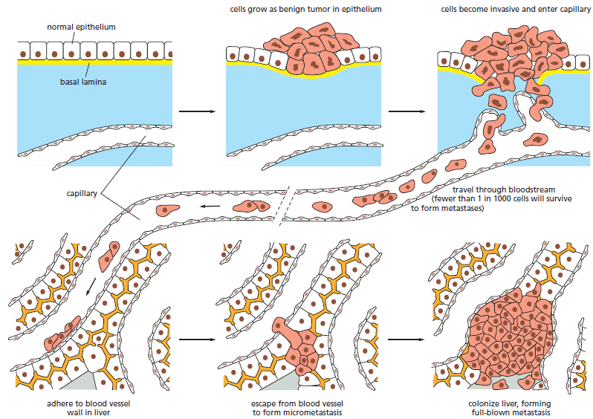
Metastasis
cells grow as benign tumor in epithelium
cells become invasive and enter capillary
normal epithelium
Loss epithelial cells
characteristics:
cell polarity
attachment to
the basal lamina
Gain mesenchymal cells
characteristics:
migration
invation
apoptotic resistance
potential to degrade extracellular matrix
basal lamina
capillary
travel through
bloodstream (fewer
than 1 in 1000 cells
will survive)
adhere to blood vessel wall in liver
escape from blood vessel to form micrometastasis
colonize liver, forming full-blown metastasis
“Epithelial-Mesenchymal
Transition (EMT)”

Slide 26
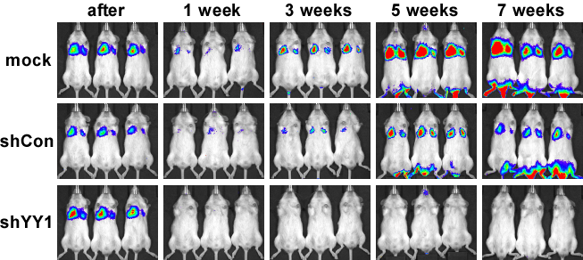

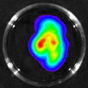

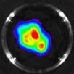

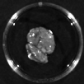
Oncogene is critical for metastasis
Cells: A549 lung cancer cells labeled with luciferase
Transplantation: intravenous injection into the tail
shYY1: YY1-silenced cells
YY1 is needed for survival & colonization
of cancer cells
Data from our work published in
Cancer Research, 2013;73(6):1787-99

Slide 27
What is the origin of tumor cells?
Tumor cells are highly proliferative
Tumor cells are highly heterogeneous
Different types of cells
Different differentiation stages
Similar to stem / progenitor cells!

Slide 28
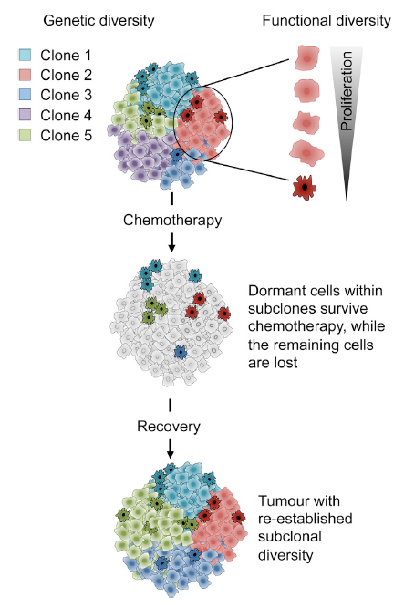
Cancer Stem Cells
Evidences
Cancer stem cells had been found in:
Leukemia
Glioma
Breast cancer
Colorectal carcinoma
Ovary cancer
Pancreatic cancer
Prostate cancer
Melanoma Myeloma
Non-melanoma skin cancer

Slide 29

Could cancer be prevented?
YES!
Alternative way of cancer prevention
Healthy life pattern
Some cancers caused by virus or bacterium
Angelina Jolie
BRCA1 gene mutation
High risk of breast & ovary cancers
Vaccine
Ex: for cervical carcinoma
Surgeries:
mastectomy, oophorectomy

Slide 30
Thank you!

